Slide 1
Phylum
Chordata
3 Subphyla ‘URO-CEPHALO-VERT’
Subphylum Urochordata
Subphylum Cephalochordata
Subphylum Vertebrata

Slide 2
Adult
Has only 1 Chordate characteristic:
Pharyngeal gill bars have become a filter feeding basket
Subphylum Urochordata
Larva
Has all 4 Chordate characteristics

Slide 3
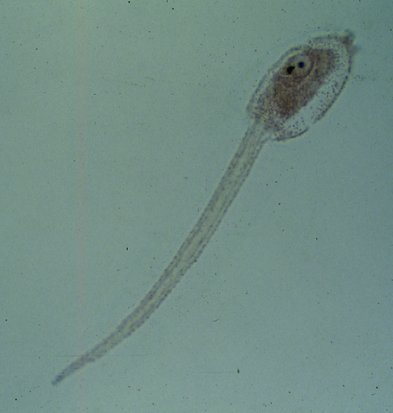
Subphylum
Urochordata
Tunicate
tadpole
larvae
Note 4 chordate
characteristics:
Dorsal hollow
nerve cord
2. Notochord
3. Pharyngeal gill slits or bars
4. Post-anal tail (A)
A

Slide 4
Subphylum Cephalochordata
Post anal tail
Notochord
Nerve cord
Anus
Atriopore
Metapleural Folds, not very visible except in cross sections
Pharyngeal gill bars & slits
Cirri

Slide 5
Phylum
Chordata
Subphylum
Cephalochordata
A
B
C
B
D
Dorsal region Note: fin ray (A), myomeres (B), dorsal
hollow nerve cord (nerve tube) (C), notochord (D)

Slide 6
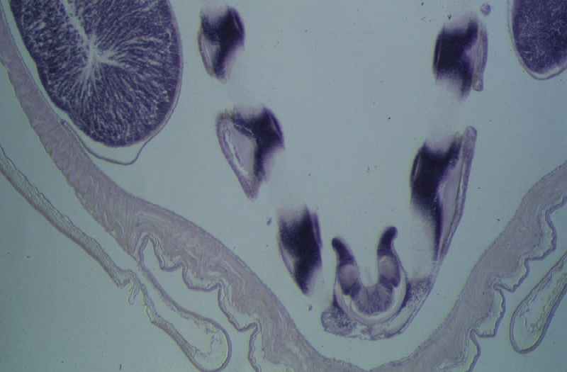
B
O
P. gill bar
Ovary
B
O
C
P gill slit
C
B
D
A
B
Phylum
Chordata
Subphylum
Cephalochordata
C
B
C
E
Endostyle
MF
MF
Anterior region Note: (D) pharynx, (E) endostyle –
(produces mucus to help catch food in between the gill
bars - Yummy!) (MF) - Meta pleural folds (A) atrium

Slide 7
Phylum
Chordata
Subphylum Vertebrata (ACOARM)
6 Classes -
Agnatha Hagfish & Lampreys
Chondrichthyes Sharks
Osteichthyes Bony fish
Amphibia Frogs & Salamanders
Reptilia
Lepidosauria (non-avian reptiles) = lizards, snakes Testudines turtles
Archosauria birds, & crocodilians (gators & crocs) Mammalia Your lab partner!

Slide 8
Phylum Chordata
Subphylum Vertebrata
TYPES of SKELETON
Cartilaginous Skeleton (2 classes)
Agnatha
Chondrichthyes
Bony Skeleton ‘RAMO’ (4 classes)
Reptilia = Lepidosauria, Testudines & Archosauria
Amphibia
Mammalia
Osteichthyes

Slide 9
Phylum Chordata
Subphylum Vertebrata
NUMBER OF HEART CHAMBERS
Agnatha
Chondrichthyes
Osteichthyes
Amphibia
Lepidosauria & Testudines
Reptilia is split
Archosauria
Mammalia
2
3
4

Slide 10
Phylum Chordata
Subphylum Vertebrata
WHO HAS AN AMNIOTIC EGG?
Amniotes – ‘RM’
Reptilia Lepidosauria,
Testudines
Archosauria
Mammalia

Slide 11
Phylum Chordata
Subphylum Vertebrata
Always take the shortest route……
If you can’t remember all the
classes that are ectothermic…
just remember the animals that
are not!
Endothermic
Birds
Mammals
Endothermy – ability to maintain body
temperature by internal metabolic processes

Slide 12
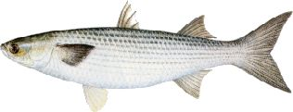
Don’t forget the dissections…….
and all those special little structures

